Slide 1
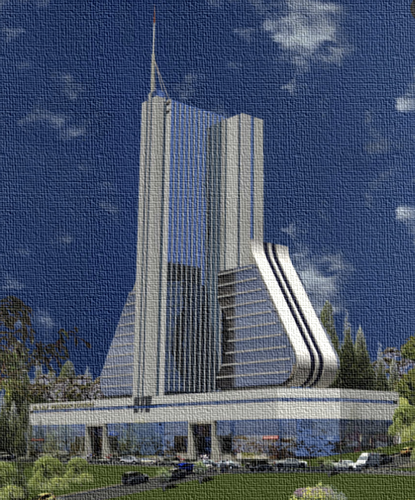

THE NATIONAL SOCIAL SECURITY FUND
22nd May 2026
Geoffrey W. Sajjabi
CHIEF COMMERCIAL OFFICER

Slide 2
FINANCIAL SERVICES SECTOR OVERVIEW
RETIREMENT BENEFITS SECTOR BREAKDOWN
Distribution of beneficiaries by scheme
78%
KEY INSIGHTS
National Social Security Fund (NSSF)
1
NSSF DOMINATES
11%
Covers about 78% of beneficiaries.
Public Service Pension Scheme
9%
Senior Citizens Grants
PUBLIC + GRANTS
2
2%
Together contribute about 20%.
Other schemes
3
OTHER SCHEMES
Have remained minimal at under 2%.
↑
Highly concentrated sector with strong growth potential in private retirement schemes.
Notes:
Brief summary: The sector is highly concentrated, with NSSF covering 78.17% of beneficiaries. Public pensions and senior grants account for about 19.85%, while other schemes remain below 2%, showing clear opportunity for growth in private and occupational retirement schemes.

Slide 3
NSSF BUSINESS MODEL
Create value for members by collecting on their behalf, investing to grow their principal and pay out an interest every year.
Contributions: 5% Member; 10% Employer
2.13 Tn collected in FY 2024/25*
Investments
Members
1
6.3%
Real Estate
The Fund
Benefits
Age, Withdrawal, Survivor’s, Midterm, Exempted Employment,
Emigration,
Invalidity
13.3%
Equities
Overheads expense ratio (0.89%)
80.4%
Fixed Income
Interest and Benefits paid
13.5% - Interest to members in FY 2024/25
1.32 Tn – Benefits paid to members in FY 2024/25
Revenue
Notes:
Brief summary: The sector is highly concentrated, with NSSF covering 78.17% of beneficiaries. Public pensions and senior grants account for about 19.85%, while other schemes remain below 2%, showing clear opportunity for growth in private and occupational retirement schemes.

Slide 4
Who is an Employer?
employers include;
According to the NSSF Act Cap 230;
An employer is any person, company,
institution, or organization that employs one or more persons under a contract of service and remunerates them directly or indirectly.
🏢 The Government
🏭 A company registered / Incorporated under the companies Act.
🤝 a Partnership registered under the partnership Act
🏢 a trustee incorporated under the Trustee Incorporation Act
1
🏭 a business registered under any other law for the time being in force governing the establishment of business entities
🤝 a governing body of an unincorporated association
🏢 a manager or subcontractor who provides employees for a principal contractor
Employer Relationship
Employer → Employs Worker → Pays Salary → Remits NSSF
NSSF Contribution Structure
Employer
10%
Employee
5%
Combined → 15% Monthly Contribution
Employers play a critical role in securing employees’ social protection and retirement savings.
Notes:
Brief summary: The sector is highly concentrated, with NSSF covering 78.17% of beneficiaries. Public pensions and senior grants account for about 19.85%, while other schemes remain below 2%, showing clear opportunity for growth in private and occupational retirement schemes.

Slide 5




Employer obligations
1
Employer Registration
Employee registration
Remit contributions by 15th
Honoring payment plans
Provision of documents and access to premises to aid inspection
Notes:
Brief summary: The sector is highly concentrated, with NSSF covering 78.17% of beneficiaries. Public pensions and senior grants account for about 19.85%, while other schemes remain below 2%, showing clear opportunity for growth in private and occupational retirement schemes.

Slide 6
Employer Compliance
A compliant employer is one that fulfills the following conditions
Benefits of Compliance
___________
Pays monthly contributions by 15th of the following month.
Motivated staff
Avoid penalties
Pays for all eligible staff.
Hope for better retirement
Good Brand image
Pays their contributions based on total emoluments.
Easy to obtain clearance
Ensures that all its employees have registered and possess valid NSSF numbers.
Avoid litigation

Slide 7





NSSF PERFORMANCE OVERVIEW
FY 2024/25 (Year ended 30 June 2025)
UGX 26.0 Tn
AUM (Total Assets Under Management)
1.78 M
Active Membership
UGX 1.32 Tn
Benefits Paid out
1
UGX 177 Bn
Average Monthly Contributions
UGX 2.13Tn Annual Contributions
Our Purpose: To make lives better by passionately dedicating ourselves to making saving a way of life, enabling more people to improve their well-being.
Notes:
Brief summary: The sector is highly concentrated, with NSSF covering 78.17% of beneficiaries. Public pensions and senior grants account for about 19.85%, while other schemes remain below 2%, showing clear opportunity for growth in private and occupational retirement schemes.

Slide 8


















NSSF INVESTMENTS
1
Etc..
Notes:
Brief summary: The sector is highly concentrated, with NSSF covering 78.17% of beneficiaries. Public pensions and senior grants account for about 19.85%, while other schemes remain below 2%, showing clear opportunity for growth in private and occupational retirement schemes.

Slide 9

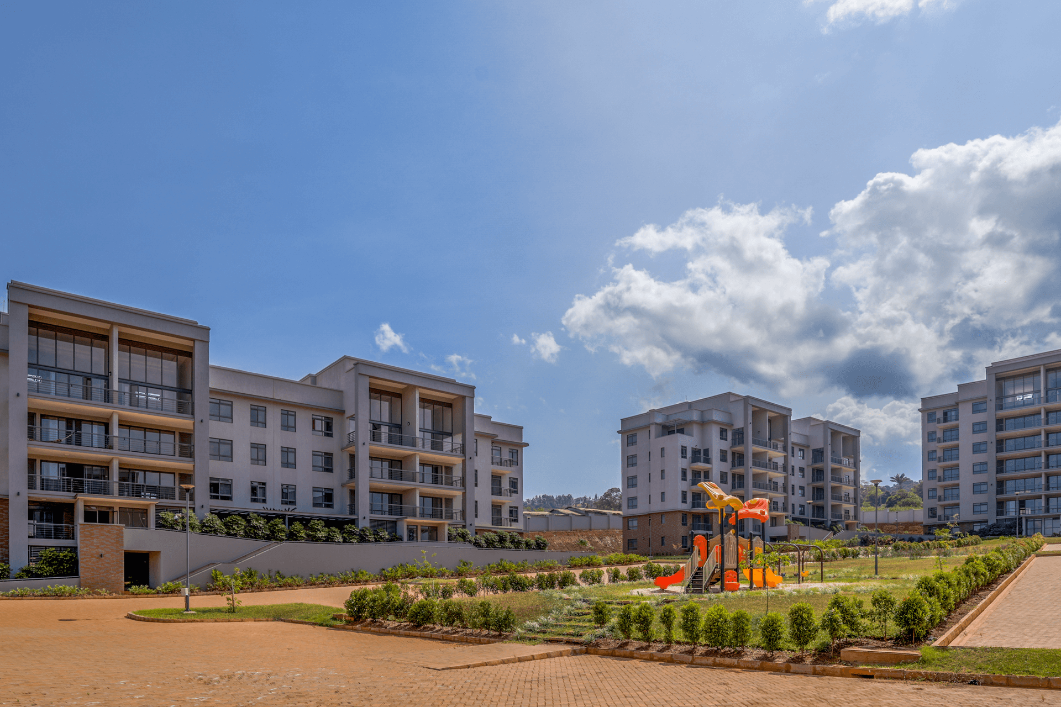
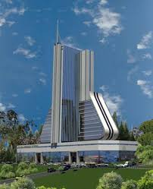

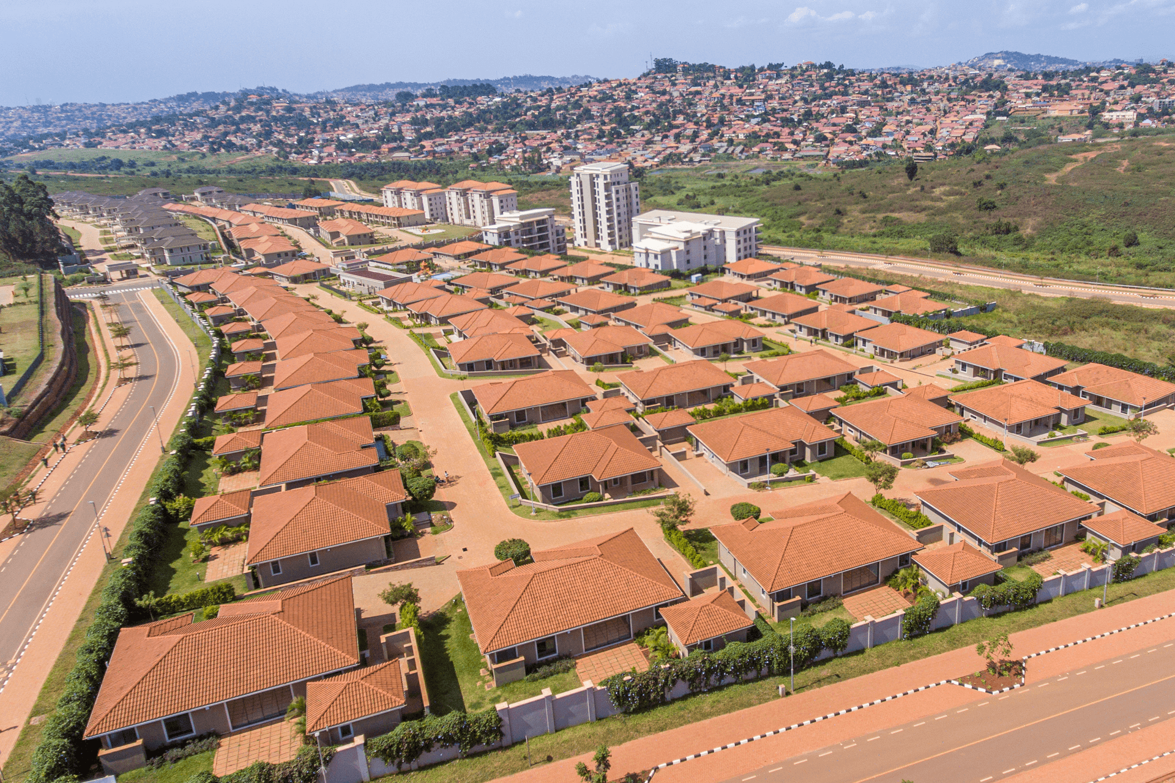
NSSF REAL ESTATE INVESTMENTS
Temangalo Housing Project
Pension Towers
Lubowa Housing Project
The Citadel Place
Offtaker Project – Kyanja
Solana Lifestyle & Residences
Etc..
1
Notes:
Brief summary: The sector is highly concentrated, with NSSF covering 78.17% of beneficiaries. Public pensions and senior grants account for about 19.85%, while other schemes remain below 2%, showing clear opportunity for growth in private and occupational retirement schemes.

Slide 10







BENEFITS PAID
EMIGRATION
Paid to members who have been working within the country and are leaving Uganda permanently.
WITHDRAWAL
Paid to those that have attained the age of 50 years, if they have been out of employment for a year.
INVALIDITY
Paid to those who lost their earning capacity (physical or mental) as verified by the Fund Doctor.
1
AGE BENEFIT
Paid to those who have reached the age of 55 whether they are still in employment or not.
EXEMPTED EMPLOYMENT
Paid to those who join employment categories that are excepted e.g., Police, Army, prisons, civil service.
SURVIVORS
Paid to the relatives of the deceased member who had been contributing to the Fund prior to their death.
MID TERM ACCESS
Paid to a member who is forty-five years of age and above and who has made contributions to the Fund for at least 10 years
Notes:
Brief summary: The sector is highly concentrated, with NSSF covering 78.17% of beneficiaries. Public pensions and senior grants account for about 19.85%, while other schemes remain below 2%, showing clear opportunity for growth in private and occupational retirement schemes.

Slide 11

NSSF Voluntary Savings Plan - Smartlife flexi
  Key Features
  The product is built on the principle of voluntary membership, giving members the flexibility to decide how much to save, when to save, for how long, and when to exit without conditions
  Any person can make voluntary contributions. Mandatory members can also make voluntary contributions as top up.
  A member may have a subaccount for a minor.
  Minimum amount per voluntary contribution is UGX 5,000. Member to state the frequency of contributions (daily, weekly, monthly, quarterly, annual or any other frequency).
  Return is computed on a daily balance but credited every month.
  There is a lock-in period for 1 year. Early exit is permitted net of any withdrawal costs.
1
Notes:
Brief summary: The sector is highly concentrated, with NSSF covering 78.17% of beneficiaries. Public pensions and senior grants account for about 19.85%, while other schemes remain below 2%, showing clear opportunity for growth in private and occupational retirement schemes.

Slide 12
THANK
YOU
THANK YOU!

