Slide 1

For every life, we are partners. For every future, we are protectors

Slide 2
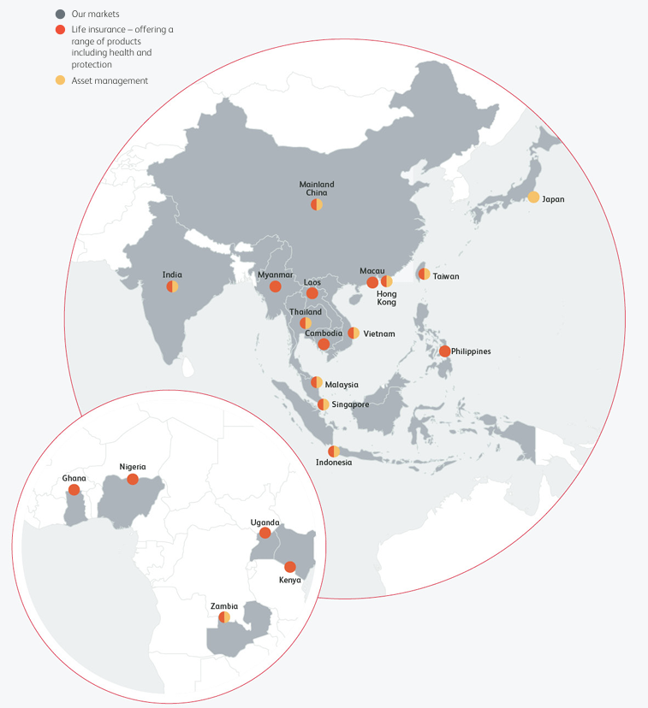
Prudential plc is a A trusted partner for millions of Our life and health insurance and asset management solutions serving over 17 million customers across 20 markets in Asia and Africa.
We are Operate in 5 Africa markets (Uganda, Kenya, Zambia, Ghana & Nigeria).
Prudential Assurance Uganda Limited (PAUL) is a licensed life insurance company providing long-term financial protection, health and investment solutions to individuals and institutions across Uganda.
28%
175+
Market Share
Years of Heritage
One of Uganda's leading life insurers
100B+
600K+
UGX Claims Paid 2025
Customer Lives Assured

Slide 3


What do we do?
Life & Health Insurance for Financial Security; Prudential Uganda bridges the financial protection gap in a country where insurance penetration remains under 1%.
Protecting Families
If a breadwinner dies too early, we pay a lump-sum to support their family. Over 75% of Ugandan households are one medical emergency away from poverty, we change that.
Securing Key Goals
Education plan payouts ensure children reach university even when life is unpredictable. Health and disability riders prevent financial derailment.
Building Long-Term Wealth
By combining protection with disciplined savings, our solutions create lasting financial safety nets, supporting wealth accumulation with claims paid within 48–72 hours.

Slide 4




What do we offer?
Our solutions are designed around the everyday realities and aspirations of Ugandans — from protecting families to building wealth for the next generation.
Life Protection
Health Protection
Education & Future Planning
Wealth Creation
Structured financial plans that help parents secure their children's education and long-term aspirations.
Disciplined savings combined with life protection to support long-term financial wellbeing and legacy planning.
Financial security for families in the event of death, disability, or unexpected life events — preserving dignity when it matters most.
Affordable healthcare financing through medical and health-linked solutions, reducing the burden of out-of-pocket costs.

Slide 5
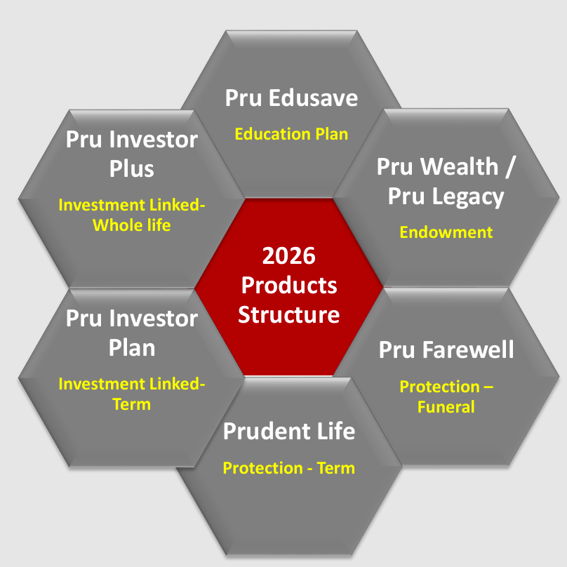
Product offering shelf
ENSURE DIGNITY & PRIDE WHEN IN OLD AGE:
Old age is a certainty, but the way you live your old age is a choice. The earlier your plan for it the better you can enjoy the final period of your life with dignity and pride.
Depending on your financial needs, we offer different products that guarantee a future for you and your loved ones even when you are no more.
ENSURE OUR CHILDREN’S EDUCATION AND THEIR FUTURE GROWTH ARE PROTECTED:
It is about providing your children with quality education options so they can continue to pursue their dreams even when you are not around.
TO ACHIEVE WEALTH ACCUMULATION, CREATION, PROTECTION & DISTRIBUTION
The ideal financial solution that can help people to safely achieve their financial goals long term
THE MOST EFFECTIVE ESTATE PLANNING SOLUTION:
The best solution to ensure a proper distribution of wealth and assets and to do legacy planning

Slide 6

New Product- PRU WEALTH (Promise to your self and your family)
A Reward for Your Commitment :(100% payout at end of term)
Your Family Stays Protected : ( Unexpected death family receives natural (100% ) and Accidental death (200%) of your cover).
Income That Continues : (Your loved ones receive 10% of your cover every year after your passing).
Protection If You Can’t Work: (If you become permanently disabled: you receive 100% of your cover/ You stop paying premiums /Your policy continues to maturity).
We Carry the Burden for You (In case of death or disability, you no longer need to pay premiums, but your policy stays active and your maturity benefit is still paid.)
A Little Extra, At No Cost (If no claims are made during your policy term, you get 3 extra years of life cover — free.)
“ALSO HAS OPTIONAL ADD ON’s”.

Slide 7

Trust. Reliability. Consistency.
At Prudential Uganda, we understand that insurance is ultimately built on trust — and trust is demonstrated most clearly when customers need us most.
Strong Claims-Paying Ability
We honour our commitments — every time.
Fast Claims Settlement
Streamlined processes ensure customers receive support quickly, with minimal friction during life's most difficult moments.
Global Expertise, Local Insight
Prudential plc's 175-year heritage, applied with deep understanding of the Ugandan market and its unique realities.
Customer-Centred Solutions
Products tailored to local realities. Service designed around the customer. Long-term partnerships built on genuine care.

Slide 8

For Every Life,
For Every Future
At Prudential Uganda, our commitment goes beyond policies. We are here to help every individual, every family, and every business build resilience, preserve dignity, and prepare confidently for whatever lies ahead.
Because when people are financially protected, communities become stronger, businesses become more resilient, and nations progress sustainably.
📞 Call Us
🌐 Visit Us Online
0800 200 052
Toll-free helpline
www.prudential.ug
📧 Email Us
info@prudential.ug
Prudential Assurance Uganda Limited — Licensed by the Insurance Regulatory Authority of Uganda

Slide 9
THANK YOU

